Slide 1
Advanced SAS Macro Programming
Crash Course
Based on the full course

Slide 2
SAS-L – SAS Internet User Group
Access either via email or newsgroup
  SAS-L is read by around 10,000 SAS users around the world
  It provides quick and plentiful answers to SAS questions
To browse, post & subscribe use
www.sas-l.com
To use from a new reader just access this group
  Comp.soft-sys.sas

Slide 3
Section 1
Style

Slide 4
Macro programming style
Best to follow programming standards
  When code follows some standards then it is easier for programmers other than the author to modify
  Can aid in detection and correction of errors
If you have no programming standards then create some

Slide 5
Use coding standards
Using a set of coding guidelines can give your programs style
  Aids in reducing errors as code is written and understanding code at a later date
Example of code not following guidelines
Slower & more difficult to understand than it could be.
%macro test(max) ;%do i=1 %to &max ; %if &i=5 %then %do ;%put Yes ;%put Lovely; %end; %else %put No ; %end ;%let time=%sysfunc(time(),time8.) ;%put time=&time ;%mend test ;%test(
10)

Slide 6
Some style guidelines
Some suggested guidelines
  Internal documentation
    Comment header block with author name, date written, description, change history, parameters, etc.
    Comments to describe what code is doing and why
  Layout
    Indenting code by 2 spaces to make code structures clear:
      DO loops, IF/THEN/ELSE
    Avoid “spaghetti code” which uses %goto statements
    Use naming conventions
  When storing macros in autocall libraries keep only one macro per member

Slide 7
Demonstration c01s1d1
This demonstration illustrates macro code that follows some style guidelines, thus making it quicker and easier to understand

Slide 8
The magic string
Sometimes SAS can get a little mixed up (or the programmer can)
Can be caused by
  Unclosed macro definition
  unclosed comments
  unfinished steps
  un-quited procs like SQL
*);*/;/*'*/ /*"*/; %MEND;run;quit;;;;;

Slide 9
Macro programming style
Some suggested standards
  Indent code to show structure, particularly of loops
  Insert blank lines for clarity
  Comment code generously
    using %* comments for macro code, using * comments for base code and /* */ comments for commenting out sections
  Include header blocks at start of macros including:
    Program description, author, date written, modification history

Slide 10
Macro programming style
Some suggested standards
  Write documentation for macros
  Everything in lower case unless it is needed for titles
  Coding optional parameters
    Macro name on %mend statement

Slide 11
Spaces and nulls
  The conditions in the following code are the same, though the quoted one is more explicit and makes things clearer
    This example checks for a null value
  The conditions for the following code checks for a space
    Since spaces are automatically removed, as in the above example, we must use one of these forms
%if &name= %then
%if "&name"="" %then
%do %while(&name=%nrstr( )) %then %put one ;
%do %while("&name"=" ") %then %put two ;

Slide 12
Commenting macros
Several kinds of SAS comments
  Type 1
    Can go anywhere in SAS code
    Not tokenized, not stored in macro, can contain semi-colons, single quotes and so on
    Best to use sparingly since they are great for commenting out code
  Type 2
    Is tokenized and stored in compiled macro
    Best for Base SAS code, as part of data steps, Procs, etc.
    /* this is a comment */
    * this is a comment ;
REVISION

Slide 13
Commenting macros
Several kinds of SAS comments
  Type 3
    Quotes must match, can’t contain semi-colons
    Displayed even if nomprint option is used
    Best for use in macro code
  Type 4
    Is tokenized and stored in compiled macro
    Old style comment kept for compatibility with older releases – avoid
  Also …
    Can comment any SAS code out by
    turning it into a macro definition
    %* this is a comment ;
    Comment this is a comment ;
%macro dummy ;
Various SAS code
%mend dummy ;
REVISION

Slide 14
Clever Commenting
Can define macro variables which contain comment symbols
  Enables comments in several places to be enabled or disabled from one place
  Useful for debugging since debugging code can be enabled or commented out easily
%let a=/;%let b=*;
&a&b
proc print data=x ;
run ;
*/;
data _null_ ;
run ;

Slide 15
Write to the log in colour
Use ERROR, WARNING or NOTE to generate output in various colours
  The keywords must be in uppercase, or it wont work
Default colours produced, though these can be redefined
  ERROR: produces red output
  WARNING: produces green output
  NOTE: produces blue output
Specifying a dash in place of the colon causes the ERROR, WARNING or NOTE text to be blanked out
%put ERROR: This is an error ;
%put WARNING: This is a warning ;
%put NOTE: Take note ;
%put ERROR- This is an error ;
%put WARNING- This is a warning ;
%put NOTE- Take note ;

Slide 16
Section 2
Configuration

Slide 17
Macro Search Path
When a macro is invoked (e.g. %myreport) SAS searches for it in these places in this sequence:
Work.Sasmacr
  Standard macros compiled in the current SAS session are stored here
Compiled Stored Macros
  This is searched if options are set appropriately
Autocall Macros
  This is defined in SAS config file and can be modified using options

Slide 18
Stored Compiled macros
How to create a stored compiled macro
Advantages
  Saves compile time when macro is used
  More secure since source code is not kept with executable
options mstored sasmstore=sasuser ;
%macro test / store ;
%put This was stored away ;
%mend test ;
REVISION

Slide 19
Stored Compiled macros
Disadvantages
  Need to maintain a separate copy of the code, since its not kept with entry
Performance implications
  Minor performance improvements possible
  Best for very long macros where compile time is more significant
Hide any data step or procedure source code
Simply put the code in a macro and compile it
Can distribute compiled code to users so they don’t have access to source code
  Useful for stopping users changing code or to protect code from exploitation by others
REVISION

Slide 20
More on stored macro libraries
All macros are compiled and by default stored in work.sasmacr
You can define multiple librefs as searchpath
Useful to define project specific macro libraries prior to general purpose macro libraries
Macros being stored are written to the first library in the path which can be written to
options sasmstore=(project all) ;

Slide 21
Deleting macros
Can delete macro variables to save memory
  Use %symdel to delete one or more macro variables from the global symbol table
  Call symdel() will do the same from a data step
The following data step can be used to delete all user defined macros
data _temp ;
set sashelp.vmacro ;
where scope='GLOBAL' ;
run ;
data _null_ ;
set _temp ;
call symdel(name) ;
run ;

Slide 22
Section 3
Productivity

Slide 23
Using keyboard macros
Create macros that record and play back program editing commands by using the keyboard macro recorder.
Define a key combination to display a program header
  Select record new macro
  Enter the header text
  Select Stop Recording
  Enter a name and description for the macro
  Click on Assign Keys
  Define a shortcut Key for ease of invocation
Other useful things to define keyboard macros for
  Code templates
  Copyright notices
Can import & export keyboard macro definitions
  Useful for sharing definitions around a company

Slide 24
Demonstration c01s3d1
This demonstration illustrates how to define and use a keyboard macro.

Slide 25
+/- to expand & collapse code
View the high-level flow of your SAS program or see each detailed statement by expanding or contracting sections of SAS procedures, DATA steps, and macros.
  Particularly useful in long programs
  Use the menu item Edit – Collapse All to get an overview of the program
REVISION

Slide 26
Program editor enhancements
To assist you in finding coding errors, the Enhanced Editor
  Automatic colour coded syntax in editor
    Makes identifying syntax errors much easier
    Particularly finding unmatched quotes is very easy
  Searches for ending brackets or parentheses when you press Ctrl + ].
  Searches for matching DO-END pairs when you press Alt + [.
    Moves between the DO & END
    Indicates if there is one missing
  Other useful key combinations
    Ctrl-shift-U – converts selected text to uppercase
    Ctrl-shift-L – converts selected text to lowercase
    Ctrl-/ - Comment out each line of code
    Ctrl-shift-/ - Remove comments from each line of code
  See complete list of keys for more
REVISION

Slide 27
Using Abbreviations
Define abbreviation which upon pressing TAB will become the longer text
  For example, you could define the abbreviation myv6sasfiles, which would expand to 'c:\winnt\profiles\myid\personal\mysasfiles\v6';
  Abbreviations are actually macros that insert one or more lines of text.
Be careful not to use names for keyboard macros which are part of SAS reserved words
  For example, using name will cause problems with libname

Slide 28
Demonstration c01s3d2
This demonstration illustrates how to define and use an abbreviation.
Notes:
To create an abbreviation
Select Tools Add Abbreviation .
In the Abbreviation field, type the name of the abbreviation.
In the Text to insert for abbreviation field, type the text that the abbreviation will expand into.
Click on OK.
To use an abbreviation, type the abbreviation. When an abbreviation is recognized, a tooltip displays the expanded text. Press the Tab key or Enter key to accept the abbreviation.

Slide 29
Section 4
Setting up and using an autocall library

Slide 30
Defining your macro library
Setup the search path for macros
Searches through each directory looking for macros
Use the SASAUTOS system option in either:
  SAS configuration file - SASv8.cfg
  Autoexec file
  As an invocation option

Slide 31
Mrecall option
  Searches autocall libraries each time a macro which was not previously found is invoked
  Useful when developing macros (in a group of programmers) to force SAS to get latest copy of macro each time
Another use of mrecall option
  Can put any SAS code in autocall libraries which can then be called by macro invocations
    We don’t have to have macros in the files
    File contents is brought in and run
    Need mrecall option
    Equivalent to a %include & submit

Slide 32
Examining macro options
To view the settings of all macro option
proc options group=macro ;
Run ;
SAS (r) Proprietary Software Release 8.2 TS2M0
NOCMDMAC Do not support command-style macros
NOIMPLMAC Do not allow statement-style macro calls
MACRO Allow use of SAS macro facility
MAUTOSOURCE Allow the macro autocall feature
MERROR Treat apparent undefined macro references as an error
NOMFILE Do not write MPRINT output to an external physical file
NOMLOGIC Do not trace macro execution
NOMPRINT Do not display SAS statements generated by macro execution
MRECALL Search autocall libraries for an undefined macro name each time the macro is
invoked
NOMSTORED Do not use stored compiled macros
MSYMTABMAX=4194304
Maximum amount of memory allocated for the macro table
MVARSIZE=4096 Maximum length of value of macro variable
SASMSTORE= Libref associated with SAS data library containing catalog of compiled stored
macros
SERROR Treat references to undefined macro variables as an error
NOSYMBOLGEN Do not write results of resolving macro variable references to SAS log

Slide 33
Advantages to using the autocall facility:
  You do not have to submit the source code for the macro definition before calling the macro.
  Conditionally executed macros are compiled only if they are actually invoked.
  You can set up multiple autocall libraries.
  Macro definitions are more easily viewed and edited with any text editor.
  Avoid the “Attack of the Clones”, where people clone macros and make changes/fixes
    Avoids ending up with 12 macros with the same name which all do almost the same thing
    Note: sasautos option should specify filerefs, not librefs

Slide 34
Section 5
Tips for creating macros

Slide 35
Defining parameters
There are several types of parameters
Fixed Parameters
  Positional parameters
    Useful when parameter is always required
    Positional parameters must come before any keyword parameters
  Keyword parameters
    Useful for optional parameters
    Parameters may have a default value associated
Unspecified parameters
  Freeform
    Using parmbuff
Mixture
  Can mix any of positional, keyword & freeform
REVISION
Notes:
Unspecified parms are explained on next slide

Slide 36
Unspecified parameters
General form of the %macro statement, with the parmbuff parameter
When using parmbuff
  Can also optionally specify positional and/or keyword parameters
  Values are accessed using &syspbuff
  Value returned includes parentheses and all text passed
    Works whether there were any positional or keyword parameters or not
%MACRO macro-name <(parameter-list)></parmbuff>;
REVISION

Slide 37
Unspecified parameters
Example
Produces the following output
%macro sales(a,type=) / parmbuff ;
%put a=&a type=&type syspbuff=&syspbuff;
%mend sales ;
%sales(car,red green blue,type=10) ;
a=car type=10 syspbuff=(car,red green blue,type=10)

Slide 38
Notes about parameter types
Positional, keyword and unspecified parameters
  With this combination you must have the unspecified parms after the positional ones and before the keyword ones
Can just have unspecified parameters too
%macro five(age,name=bill) / parmbuff ;
%five(22,and other stuff I want,name=john) ;
%macro six / parmbuff ;
%six(These are my parameters,
I,can,include,commas,or=equals signs) ;

Slide 39
Make your own DMS commands
DMS commands are Display Management System commands
This is done by defining a command macro
  Use the /cmd parameter on the %macro statement
what to use them for
  Make your own custom commands
  Combine a range of commands
  Include conditional logic in commands
%macro sample / cmd ;

Slide 40
Make your own DMS commands
Options required
  Cmdmac
    Check 1st word of any text in window to see if it is a command style macro invocation
    Nocmdmac is default and does not check for command style macro invocations
Example
options cmdmac ;
%macro cont / cmd ;
submit 'proc contents data=sasuser._all_;run;';
output ;
%mend cont ;

Slide 41
Create your own SAS statements
Do this by using statement style macros
  Use the /stmt parameter on the %macro statement
  Also need the implicit macro options turned on
This specifies that the macro processor examine the first word of every submitted statement to see whether it is a statement-style macro invocation.
Advantage
  Allows you to create new SAS statements which make programming easier or similar to other languages
Disadvantage
  Not as efficient as name style macro calls since then only macro invocations following a percent sign are searched for
Options implmac;

Slide 42
Demonstration c01s6d1
This demonstration illustrates how to create your own SAS statements.

Slide 43
Section 6
Interactive Macros

Slide 44
Syntax of %window and %display
The %window statement defines customized windows
The %display statement displays a macro window
%WINDOWwindow-name<window-option(s)>|field-definition(s);
%DISPLAY window<NOINPUT><BLANK><BELL><DELETE>;

Slide 45
Defining a window to fill screen
Use %window to define screen layout
  Place text at line & column position using #, /, @ and +
  Control window attributes using color and attr
%window welcome color=white
#5 @28 'Welcome to SAS.‘
#7 @15 "You are executing Release &sysver
on &sysday, &sysdate.."
#12 @29 'Press ENTER to continue.' ;
%display welcome ;
Notes:
- 2 periods are required as delimiter for &sysver, &sysday and &sysdate

Slide 46
Defining a smaller message window
Can make window take up a prescribed area by using columns & rows
Can also specify attributes for text
%window Message_Window
color=yellow columns=60 rows=10
#2 'Note: your program is running'
color=blue attr=underline
" at %sysfunc(time(),time8)"
color=red ;
%display message_window ;

Slide 47
Defining windows with several groups
Syntax
Use group= to define different groups of fields which can be displayed separately
  Alternatively we could define separate windows
%WINDOWwindow-name
group-definition(s)|field-definition(s);
%window Error_Window color=red columns=52 rows=10
group=mild
#2 'Error: your program has a slight problem'
color=white
group=severe
#2 'Error: evacuate - call the police!!!'
color=yellow ;
%display error_window.mild ;
%display error_window.severe ;

Slide 48
Windows which don’t need user input
Status & progress windows can be displayed by using the noinput parameter on %display
Groups that are displayed persist when noinput is used inside a macro
Can use the blank parameter to clear the window before displaying the group
The delete parameter will remove the window after it is displayed

Slide 49
Function keys and menus within windows
The menu= option can be used to define PMENUs on %window
The keys= options can be used to define function key definition entries saved via the KEYS window
  Can define function keys with the keydef command
    keydef f1 dir sasuser
    %keydef 'ctl rmb' 'zoom';
proc pmenu cat=test;
menu windows;
item 'Primary windows‘
menu=prime;
menu prime;
item output;
item manager;
item log;
item pgm;
run;
%window test
menu=test.windows
keys=sasuser.mykeys
'Pick something' ;

Slide 50
Windows which don’t need user input
%window Progress_Window columns=50 rows=10 color=gray
group=s1b #2 "Stage 1 begun" color=white
group=s1c #2 "Stage 1 complete" color=white
group=s2b #3 "Stage 2 begun" color=white
group=s2c #3 "Stage 2 complete" color=white
group=s3b #4 "Stage 3 begun" color=white
group=s3c #4 "Stage 3 complete" color=white
;
Window to display progress

Slide 51
Demonstration c01s4d1
This demonstration illustrates the use of macro windows to display completion of stages of a program

Slide 52
Getting input from users via windows
Simply define macro variables in your window definition
This example defines 2 macro variables
  User
  pwd
Example
%window logon columns=70 rows=8
#1 "Enter user name: " user 16
#2 "Enter password: " pwd 8 ;
%display logon ;
%put user=&user pwd=&pwd ;

Slide 53
Getting input from users via windows
Improve code by:
  Making fields required using required=yes
  Automatically going to next field when current one is full using autoskip=yes
  Hide what is typed for password using display=no
%window logon columns=70 rows=8
#1 "Enter user name: " user 16 autoskip=yes required=yes
#2 "Enter password: " pwd 8 required=yes display=no ;
%display logon ;
%put user=&user pwd=&pwd ;

Slide 54
Notifying user during macro execution
%let sysmsg=message-text;
Quite useful in displaying status messages or instructions for users in the message area at the bottom of the screen

Slide 55
Demonstration c01s4d2
This demonstration illustrates the use of macro windows to display percentage complete of a program

Slide 56
Demonstration c01s4d3
This demonstration illustrates the use of macro windows to simulate a progress bar

Slide 57
Section 7
Some useful macros

Slide 58
Syntax for %SYSFUNC
Execute SAS functions or user-written functions
function is the name of the function
format is a SAS format to apply to the results.
Qsysfunc is the same as Sysfunc except it masks the same characters as the %NRBQUOTE function, i.e.
& % ' " ( ) + - * / < > = ¬ ^ ~ ; , blank AND OR NOT EQ NE LE LT GE GT
%SYSFUNC (function(argument(s))<,format>)
%QSYSFUNC (function(argument(s))<,format>)

Slide 59
Functions that can be used with %sysfunc
Some functions that are available
  Time, Date & datetime
    Date & time values
  Putn, putc, inputn, inputc
    Combination of values with formats
  Exist, fexist
    Existence of files/datasets
  Open, close, attrn, attrc
    Sas dataset I/O
  Intck, intnx
    Increments & counts datetime intervals
  Pathname
    Gets physical file assignments
  Log, min, max, sum
    Mathematical functions
Some functions
which are not available
  DIF
  DIM
  HBOUND
  IORCMSG
  INPUT
  LAG
  LBOUND
  MISSING
  PUT
  RESOLVE
  SYMGET
  All Variable Information Functions
REVISION

Slide 60
Defining useful characters
Registered Trademark sign
  Can either press ALT 0174 or use byte(174)
Copyright sign
  Can either press ALT 0169 or use byte(169)
Note: If using ALT technique must use numeric keypad
%let tm=%sysfunc(byte(174)) ;
%let c=%sysfunc(byte(169)) ;

Slide 61
Implementing =: in macro language
In data step the =: operator is used for “begins with”, e.g.
  If name=:’M’ then put ‘Name starts with M’ ;
  Such an operator doesn’t exist in macro language
Can implement this in macro language
%macro eq(a,b) ;
%let len=%length(&b) ;
%if &b=%substr(&a,1,&len) %then
1 ;
%else
0 ;
%mend eq ;
%put %eq(dog,D);

Slide 62
Using a dataset label in titles
A useful macro to return the label of a dataset
  Can then be used in various places such as titles & footnotes
%macro dslab(dset) ;
%let dsid=%sysfunc(open(&dset)) ;
%let label=%sysfunc(attrc(&dsid,label)) ;
%let rc=%sysfunc(close(&dsid)) ;
&label
%mend dslab ;
title “Label is %dslab(sasuser.houses)” ;

Slide 63
Using a variable label in titles
A useful macro to return the label of a variable from a dataset
  Can then be used in various places such as titles & footnotes
%macro varlab(dset,var) ;
%let dsid=%sysfunc(open(&dset)) ;
%let label=%sysfunc(varlabel(&dsid,
%sysfunc(varnum(&dsid,&var)))) ;
%let rc=%sysfunc(close(&dsid)) ;
&label
%mend varlab ;
Title “Label is %varlab(sasuser.houses,style)” ;

Slide 64
Using multiple functions with %sysfunc
Can’t nest functions within a %sysfunc, the following does not have the desired effect
Can nest %sysfunc’s
%let num= abc ;
%let x=%sysfunc(compress(upcase(&num)));
%put x=&x;
x=upcase(abc)
%let num= abc ;
%let
x=%sysfunc(compress(%sysfunc(upcase(&num))));
%put x=&x;
x=ABC

Slide 65
Macro to make a SAS format based on a dataset
Create a format called $street
Use the format to return a price based on a street
%macro mkfmt(dset,start,label,fmtname,lib=work) ;
data __temp / view=__temp ;
set &dset(rename=(&start=start &label=label)) ;
retain fmtname "&fmtname" ;
run ;
proc format cntlin=__temp lib=work fmtlib ;
run ;
%mend mkfmt ;
%mkfmt(sasuser.houses,street,price,$street)
Cost=put(‘Vine Street’,$street.) ;

Slide 66
Demonstration c01s1d2
This demonstration illustrates creating a format based on 2 variables in a dataset

Slide 67
Section 8
Putting Macros into Production

Slide 68
Detecting when Procedures and Data Steps fail
&Syserr is very useful in detecting when procedures or datasteps have failed
The following code contains errors and produces syserr values of 3000 & 1012, respectively.
proc print data=doesnot_exist;
run ;
%put Syserr=&syserr;
data _null_ ;
x==1;
run ;
%put Syserr=&syserr;

Slide 69
Useful automatic macro variables: &syserr
Return code set by some PROCs and data step
Value | Description
0 | Execution completed successfully and without warning messages.
1 | Execution was cancelled by a user with a RUN CANCEL statement.
2 | Execution was cancelled by a user with an ATTN or BREAK command.
3 | An error in a program run in batch or non-interactive mode caused SAS to enter syntax-check mode.
4 | Execution completed successfully but with warning messages.
>4 | An error occurred. The value returned is procedure dependent.

Slide 70
Using &sysinfo to determine degree of success of a dataset comparison
&sysinfo
  Provides return codes from some SAS procedures, such as COMPARE, UPLOAD and DOWNLOAD
proc compare base=x compare=y ;
run ;
%if &sysinfo=0 %then
%put Datasets were identical ;
%else
%if &sysinfo>64 %then
%put There were some differences ;
%else
%put there were only minor differences ;
This example code determines how different datasets are and issues a message

Slide 71
Using values of &sysinfo to check result of PROC COMPARE and take action
See sysinfo demo
  Values ordered from least to most different
    Aids in testing values
Macro Return Codes
Bit | Condition | Code | Hex | Description
1 | DSLABEL | 1 | 0001X | Data set labels differ
2 | DSTYPE | 2 | 0002X | Data set types differ
3 | INFORMAT | 4 | 0004X | Variable has different informat
4 | FORMAT | 8 | 0008X | Variable has different format
5 | LENGTH | 16 | 0010X | Variable has different length
6 | LABEL | 32 | 0020X | Variable has different label
7 | BASEOBS | 64 | 0040X | Base data set has observation not in comparison
8 | COMPOBS | 128 | 0080X | Comparison data set has observation not in base
9 | BASEBY | 256 | 0100X | Base data set has BY group not in comparison
10 | COMPBY | 512 | 0200X | Comparison data set has BY group not in base
11 | BASEVAR | 1024 | 0400X | Base data set has variable not in comparison
12 | COMPVAR | 2048 | 0800X | Comparison data set has variable not in base
13 | VALUE | 4096 | 1000X | A value comparison was unequal
14 | TYPE | 8192 | 2000X | Conflicting variable types
15 | BYVAR | 16384 | 4000X | BY variables do not match
16 | ERROR | 32768 | 8000X | Fatal error: comparison not done

Slide 72
Automatic notification of Problems via email
More useful automatic macro variables
&syssite
Holds SAS site number – useful when reporting problems to SAS
&sysuserid
Userid of user who is running the SAS session/job
&sysver
Version of SAS being used, e.g. 6.12 or 8.2
&sysvlong/&sysvlong4
Shows the SAS release number and
maintenance level of SAS software

Slide 73
Automatic notification of Problems via email
Detect an error requiring an email
Call the email macro, passing &sysmacroname in so we know which macro failed
Send the email using a range of useful values
Support person can receive email and potentially have enough information to pass on to SAS technical support

Slide 74
Demonstration c02s2d3
This demonstration illustrates how to raise an email containing useful information when a macro fails

Slide 75
Section 9
Calling functions and routines

Slide 76
SysFunc and QSysFunc
Just as the swiss-army knife has 101 uses, so does the %sysfunc and %qsysfunc macro function
What’s it for?
  Can call almost any SAS data step function
  Can format the result of the function call
  Can nest function calls
  Can use in open code as well as in macros
REVISION

Slide 77
Putting dates into Titles and Footnotes
Putting a date into a title
To make more sense of it we can use the format parameter
Title "Today is %sysfunc(date())" ;
Footnote "Today is %sysfunc(date(),worddate.)" ;
REVISION

Slide 78
Using %QSysFunc
%qsysfunc does the same as %sysfunc, but masks the following:
  & % ' " ( ) + - * / < > = ¬ ^ ~ ; , blank AND OR NOT EQ NE LE LT GE GT
  Produces the following message
  But changing %sysfunc to %qsysfunc produces
%macro test(date) ;
%put Today is &date ;
%mend test ;
%test(%sysfunc(date(),worddate.)) ;
Fails because worddate. returns a value that has commas in it. Using date9. would not fail.
ERROR: More positional parameters found than defined.
Today is January 10, 2002

Slide 79
Using call routines from macro language
%syscall can use any SAS call routine except LABEL, VNAME, SYMPUT, and EXECUTE
  Can also use those created using SAS toolkit
  Must call with macro variable names (without &)
Example
New to MVS, CMS & Open VMS in SAS version 8
%let a = 123456;
%let b = 0;
%syscall ranuni(a,b);
%put &a, &b;
Notes:
SAS CALL Routines: CALL RANUNI Routine
RANUNI(seed,x);
The CALL RANUNI routine updates seed and returns a variate x generated from the uniform distribution on the interval (0,1), using a prime modulus multiplicative generator with modulus 2*31- 1 and multiplier 397204094 (Fishman and Moore 1982). The seed must be initialized prior to the CALL statement.

Slide 80
Section 10
Making Numerical Calculations

Slide 81
Problems with %eval
%eval
%eval works with integers only
  However if floating point numbers are used then it fails
    Produces the following error message
  %Eval is useful for incrementing counters
%let x=%eval(1+2) ;
%let x=%eval(1.0+2.) ;
ERROR: A character operand was found in the %EVAL function
or %IF condition where a numeric operand is required.
The condition was: 1.0+2.
REVISION

Slide 82
Syntax of %sysevalf
%SYSEVALF(expression<,conversion-type>)
Evaluates arithmetic and logical expressions using floating-point arithmetic
Conversion type converts value returned from evaluation to another value, valid values are:
  Boolean, 0 if zero or missing, otherwise 1
  Ceil, smallest integer bigger than result
  Floor, largest integer less than result
  Integer, integer portion of result

Slide 83
Evaluating floating point arguments
%sysevalf must be used when doing floating point calculations
    can optionally convert values returned using one of the following methods:
    Boolean returns a 0 if result was 0 or missing, otherwise returns a 1
    Ceil returns smallest integer larger than result
    Floor returns largest integer smaller than result
    Integer returns integer part of result, by truncating the decimal part
%let x=%sysevalf(1.0+2.) ;

Slide 84
Using floating point in comparisons and loops
Logic in the %IF, %DO %UNTIL and %DO %WHILE statements use %eval to evaluate logical conditions
  Means that any numbers with decimal points are evaluated as text
  Can use %sysevalf to be able to use floating point
%macro test ;
%if 1000.0<9 %then
%put 1000.0 is smaller than 9 when using an IF … ;
%if %sysevalf(1000.0>9) %then
%put ... but 1000.0 is larger than 9 when using a sysevalf with an IF! ;
%mend test ;

Slide 85
When do we get a macro Overflow Error
The %eval function can only evaluate a number less than 2,147,483,647 (32 bit).
In macro language %eval functions are used to evaluate expressions with these statements:
%put %eval(2147483647);
%put %eval(2147483648);
%put %sysevalf(2147483648000);
%do until
%do .. %to ..
%do %while
%if .. %then..

Slide 86
Section 11
Affecting macro flow

Slide 87
Syntax of %GOTO and %label:
%GOTO label;
Branches macro processing to the specified label
  Can be a shortcut method of coding, but generally not good practice to use
    Can produce spaghetti code
  Label can be either an actual label or a macro variable or invocation which resolves to a macro label
  Defines a label which can be used in a %GOTO statement
  Labels are defined using “%name:” followed by a macro statement, text expression or constant text
%label: macro-text

Slide 88
Ways to use %GOTO
  If we have the following label definitions…
  Then we can go to it like this …
  Or this …
  Or this …
%lab1: %let this=that ;
%lab2: %mend ;
%lab3: x=x+2 ;
%goto lab1 ;
%let lab=lab2;
%goto &lab;
%macro lab ;
lab2
%mend lab ;
%goto %lab ;

Slide 89
Looping with dates & exponents
Useful for generating datastep code or any repetitive process
Can use simple loops, dates, times, irregular loops, etc.
%macro loop ;
%do i=1 %to %sysevalf(10**2) %by 22 ;
%put i=&i ;
%end ;
%do i=%sysevalf('1jan2002'd) %to %sysevalf('31jan2002'd) %by 7 ;
%put Date=%sysfunc(putn(&i,date9.)) ;
%end ;
%mend loop ;
%loop

Slide 90
Branching & Iterative step execution
  Limitations of iterative DO loops
    Missing the base statements LEAVE & CONTINUE
    Can not do loops with decimal values, only integer values can be used, the following code fails
%macro loop ;
%do i=1.1 %to 2.1 ;
%put i=&i ;
%end ;
%mend loop ;
%loop
ERROR: A character operand was found in the %EVAL function or %IF condition where a numeric operand is required.
The condition was: 1.1
ERROR: The %FROM value of the %DO I loop is invalid

Slide 91
Implementing loops which use floating point values
Create a loop using manual loop variable increment and %IF .. %THEN %GOTO
%macro loop ;
* starting value ;
%let i=1.1;
* label for top of loop ;
%top: %put i=&i ;
* increment loop variable ;
%let i=%sysevalf(&i+2.1) ;
* return to top of loop if value is under limit ;
%if %sysevalf(&i<=10.5) %then %goto top ;
%mend loop ;

Slide 92
Section 12
Quoting functions

Slide 93
Introduction to macro quoting
Quoting in macro language masks (or hides) the functionality of special characters and mnemonics
  If we do the following:
    %let xxx=candle ;
  Then referring to &xxx would usually resolve to:
    candle
  But if &xxx was quoted, causing the & to be treated as text, then it would resolve to:
    &xxx
  Quoting stops special characters/mnemonics doing their job, although they still look the same.
  This applies to all SAS, not just macro language.

Slide 94
Summary of Special Characters and Macro Quoting Functions
Group | Items | Macro Quoting Functions
A | + -- */<>=¬^|~;, blank AND OR NOT EQ NE LE LT GE GT | all
B | &% | %NRSTR, %NRBQUOTE, %SUPERQ, NRQUOTE
C | unmatched' "() | %BQUOTE, %NRBQUOTE, %SUPERQ, %STR*, %NRSTR*, %QUOTE*, %NRQUOTE*
Function | Affects Groups | Works at
%STR | A, C* | macro compilation
%NRSTR | A, B, C* | macro compilation
%BQUOTE | A, C | macro execution
%NRBQUOTE | A, B, C | macro execution
%SUPERQ | A, B, C | macro execution (prevents resolution)
%QUOTE | A, C* | macro execution. Requires unmatched quotation marks and parentheses to be marked with a percent sign (%).
%NRQUOTE | A, B, C* | macro execution. Requires unmatched quotation marks and parentheses to be marked with a percent sign (%).
*Unmatched quotation marks and parentheses must be marked with a percent sign (%) when used with %STR, %NRSTR, %QUOTE, and %NRQUOTE.

Slide 95
Unmasks all special characters and mnemonic values
  %UNQUOTE is useful in situations where you want to do this, for example
%let drugname=Tenormin;
%let drug=%str(%'&drugname%') ;
data _null_ ;
put "drug=" &drug;
run ;
%let resolved=%unquote(&drug) ;
%put resolved=&resolved ;
data _null_ ;
put "resolved=" &resolved;
run ;
ERROR 22-322: Syntax error, expecting one of the following: a name, a quoted string, arrayname, #, (, +, /, //, ;, @, @@, OVERPRINT, _ALL_, _BLANKPAGE_, _ODS_, _PAGE_.
resolved=Tenormin

Slide 96
Removing leading and/or trailing blanks
%qtrim & %qleft do the same as their counterparts, but also mask the following:
Examples
%left
removes leading
blanks
%trim
removes trailing
blanks
& % ' " ( ) + - * / < > = ¬ ^ ~ ; ,
Blank AND OR NOT EQ NE LE LT GE GT
%let name=*%left(&name)* ;
%let nasty=%qleft(&;’”) ;

Slide 97
%LET macro statement and %STR & %NRSTR
Assigns values to macro variables
Trims leading and trailing spaces
Can include leading & trailing spaces if combined with %str or %nrstr functions
%str masks the following special characters & mnemonic strings
  + - * / < > = ¬ ^ ~ ; , blank AND OR NOT EQ NE LE LT GE GT
  Also masks these extra characters if they are preceded by a %
    ' " ( )
%nrstr masks everything that %str does, plus the following
  & %
%let name= Phil Mason ;
%let name=%str( Phil Mason );
%let room=%str(John%’s office) ;
%let group=%nrstr(Me&Fred) ;
REVISION

Slide 98
%str/%nrstr vs. %quote/%nrquote
These functions all mask the same items:
  + - * / < > = ¬ ^ ~ ; , blank AND OR NOT EQ NE LE LT GE GT
  They also mask the following if they occur in pairs
    ' " ( )
  %str/%nrstr work at macro compilation time
  %quote/%nrquote work at macro execution time
  Macro functions beginning with NR also mask the characters & %
48 %macro demo(parm) ;
49 %put parm=&parm comp=%nrstr(&parm)
50 exec=%nrquote(&parm) ;
51 %mend demo ;
52 %demo(OR)
parm=OR comp=&parm exec=OR
Notes:
Move to an example or delete

Slide 99
%NRSTR is a good choice when keeping macro variables unresolved
Program
Log
%let var=variable resolved ;
%put %nrstr(This shows a macro &var rather than its resolution);
6 %put %nrstr(This shows a macro &var rather than its resolution) ;
This shows a macro &var rather than its resolution
REVISION

Slide 100
%STR is a good choice when producing whole SAS statements
%macro pick(choice) ;
%if &choice=1 %then
%str(put name sex age ;) ;
%if &choice=2 %then
%str(put _all_ ;) ;
%mend pick ;
data _null_ ;
set sashelp.class ;
%pick(1)
run ;
REVISION

Slide 101
Using %QUOTE to mask mnemonics
%QUOTE is used in the following example to avoid this error:
Program
ERROR: A character operand was found in the %EVAL function or %IF condition where a numeric
operand is required. The condition was: &state=nc
ERROR: The macro DEPT2 will stop executing.
%macro dept(state);
%if %quote(&state)=nc %then
%put North Carolina ;
%else
%put Somewhere else - &state ;
%mend dept;
%dept(or)

Slide 102
%Bquote & %nrbquote
Both mask special characters and mnemonic operators in a resolved value
  Characters masked are:
    ' " ( ) + - * / < > = ¬ ^ ~ ; , blank AND OR NOT EQ NE LE LT GE GT
%bquote does not mask these 2 characters, whereas %nrbquote does:
    % &
  But this works fine…
%put path=%sysget(path) ;
ERROR 180-322: Statement is not valid or it is used out of proper order.
%put path=%bquote(%sysget(path)) ;
Notes:
Possibly use example from online doc

Slide 103
Using %SUPERQ when you want to ignore macro functionality
%SUPERQ is the only macro function which prevents resolution of macro variables
  Only accepts the name of a macro variable, without ampersand
  Takes a “picture” of the macro variable contents
  Does not do any resolution

Slide 104
Example of masking all macro resolution using %SUPERQ
data _null_;
call symput('mv1','Smith&Jones');
call symput('mv2','%macro abc;');
run;
%put Macro variable TESTMV1 is &mv1;
%put Macro variable TESTMV2 is &mv2;
WARNING: Apparent symbolic reference JONES not resolved.
ERROR: Open code statement recursion detected.
%put Macro variable TESTMV1 is %superq(mv1);
%put Macro variable TESTMV2 is %superq(mv2);
Macro variable TESTMV1 is Smith&Jones
Macro variable TESTMV2 is %macro abc;

Slide 105
Section 13
Macro variables & Data Set variables

Slide 106
Syntax for Call Execute
Used from a data step and resolves its argument and executes the resolved value at the next step boundary
CALL EXECUTE (argument);

Slide 107
Some different ways to use Call Execute
Builds SAS code which is run after the current data step completes
useful for:
  building macro definitions
  Building macro invocations
  Building data step code
  Passing data step values to macros as parameters
Call execute('%macro runit;%let this=that;%mend runit’);
Call execute(‘%runit’) ;
Call execute(‘data _null_;x=1;run;’) ;
Data _null_ ;
set info ;
call execute(‘%invoice(‘!!customer!!’);’) ;

Slide 108
Syntax of RESOLVE() function
RESOLVE(argument)
Resolves the value of a text expression during DATA step execution
  Resolve() works with a macro variable or macro invocation at data step execution time
  Argument must be in single quotes, otherwise it will be resolved before the data step is run

Slide 109
Resolving macro expressions at data step execution time
Why use resolve()?
  useful for passing macro values in to data step at data step execution time
  Accepts a wider range of arguments than symget
    Can resolve macro variables or macro programs
    Can resolve more than one macro variable at once
  Can return different values at each iteration of the data step
X=resolve(‘&name’) ;
Y=resolve(‘%get_name’) ;
Z=resolve(‘&first &last’) ;

Slide 110
Demonstration c03s1d1
This demonstration illustrates using the RESOLVE() function to resolve macro expressions at execution time

Slide 111
SAS log showing a comparison of various forms of resolution
224 %let x=0;
225 %let y=10;
226 data _null_ ;
227 do i=1 to 3 ;
228 call symput('x',put(i,1.)) ;
229 direct=&x ;
230 symget=input(symget('x'),1.)+input(symget('y'),2.) ;
231 resolve=resolve('&x+&y') ;
232 resolve2=resolve('%eval(&x+&y)') ;
233 put _all_ ;
234 end ;
235 run ;
i=1 direct=0 symget=11 resolve=1+10 resolve2=11 _ERROR_=0 _N_=1
i=2 direct=0 symget=12 resolve=2+10 resolve2=12 _ERROR_=0 _N_=1
i=3 direct=0 symget=13 resolve=3+10 resolve2=13 _ERROR_=0 _N_=1

Slide 112
Working with datasets from macro language
The key is using Base SAS dataset I/O functions
  To use these we also need the macro function %sysfunc
Allows us to do many things with datasets directly from macro language
  Open & close datasets
  Read & write variable values
  Add & Delete observations
  Add & Delete variables

Slide 113
Syntax for Dataset Functions
OPEN(<data-set-name<,mode>>)
Opens a SAS data set
and returns a value
CLOSE(data-set-id)
Closes a SAS data set
and returns a value
Reads the next nondeleted observation from a SAS data set into the Data Set Data Vector (DDV) and returns a value
FETCH(data-set-id <,'NOSET'>)
FETCHOBS(data-set-id,obs-number<,options>)
Reads a specified observation from a SAS data set into the Data Set
Data Vector (DDV) and returns a value

Slide 114
More syntax for dataset functions
CALL SET(data-set-id);
Links SAS data set variables to DATA step or macro variables that have the same name and data type
Returns the value of a SAS data set character variable
Returns the value of a numeric attribute for the specified SAS data set
GETVARC(data-set-id,var-num)
GETVARN(data-set-id,var-num)
ATTRN(data-set-id,attr-name)
ATTRC(data-set-id,attr-name)

Slide 115
Automatically create macro variables from dataset variables
%let name=Old Tom;
Usually create macro variables like this …
But can also create them like this …
    Which gets the value of the 3rd dataset variable from the dataset and assigns it to the macro variable name
Or more easily like this …
    This is similar to the data step statement
    This creates a macro variable for each dataset variable
    Dataset used is referred to by the value of the macro variable dsid
%let name=%sysfunc(getvarc(&dsid,3)) ;
%syscall set(dsid) ;
Call set(dsid) ;

Slide 116
Steps to work with datasets from macro language
The following steps are needed to use datasets from macro language
  Open dataset
  Optionally use %syscall set to map dataset variables to macro variables
  Get values from dataset using fetch or fetchobs
  Optionally assign value to macro variable, if you didn’t do the %syscall
  Close dataset

Slide 117
Example – reading values from variables on a dataset
%macro loop ;
%let dsid=%sysfunc(open(sasuser.houses)) ;
%let nlobs=%sysfunc(attrn(&dsid,nlobs)) ;
%syscall set(dsid) ;
%do i=1 %to &nlobs ;
%let rc=%sysfunc(fetch(&dsid)) ;
%put i=&i street=&street price=&price rc=&rc ;
%end ;
%let rc=%sysfunc(close(&dsid)) ;
%mend loop ;

Slide 118
Example – reading values from a particular variable in a particular observation on a dataset
%macro loop(obs) ;
%let dsid=%sysfunc(open(sasuser.houses)) ;
%let nlobs=%sysfunc(attrn(&dsid,nlobs)) ;
%let rc=%sysfunc(fetchobs(&dsid,&obs)) ;
%let varnum=%sysfunc(varnum(&dsid,street)) ;
%let street=%sysfunc(getvarc(&dsid,&varnum));
%put street=&street ;
%let rc=%sysfunc(close(&dsid)) ;
%mend loop ;

Slide 119
Macros containing lists of values can be built in various ways
  Simple list
  List from a dataset using macro language
%let list=“Euston Road” “Paddington Street”;
%macro loop ;
%global list ;
%let list=;
%let dsid=%sysfunc(open(sasuser.houses
(where=(price>100000)))) ;
%let nlobs=%sysfunc(attrn(&dsid,nlobs)) ;
%syscall set(dsid) ;
%do %while(%sysfunc(fetch(&dsid))=0) ;
%let list=&list "&street" ;
%end ;
%let rc=%sysfunc(close(&dsid)) ;
%mend loop ;

Slide 120
Section 14
Dataset information from macros

Slide 121
Syntax for existence functions
EXIST(member-name<,member-type>)
Verifies the existence of a SAS data library member
Verifies the existence of an external file associated with a fileref and returns a value
Verifies the existence of an external file by its physical name and returns a value
FEXIST(fileref)
FILEEXIST(file-name)

Slide 122
Test whether SAS datasets exist or not
%macro exists(dset) ;
%if %sysfunc(exist(&dset)) %then
%put &dset does exist ;
%else
%put &dset does not exist ;
%mend exists ;
%exists(sasuser.houses) ;

Slide 123
Test whether an external file exists
Can also use the FEXIST function which works with Filerefs, rather than external file names
%macro fexists(file) ;
%if %sysfunc(fileexist(&file)) %then
%put &file does exist ;
%else
%put &file does not exist ;
%mend fexists ;
%fexists('c:\temp\test.txt') ;

Slide 124
Counting observations in a data set
Count number of observations using macro language
Can change nobs parameter on ATTRN function to nlobs to count logical observations rather than total observations
%macro nobs(dset) ;
%let dsid=%sysfunc(open(&dset)) ;
%sysfunc(attrn(&dsid,nobs))
%let dsid=%sysfunc(close(&dsid)) ;
%mend nobs ;
%put sasuser.houses has
%nobs(sasuser.houses) observations ;

Slide 125
Counting observations in a data set
Can write a macro to count observations which meet a specific condition
%macro wobs(dset,cond) ;
%let dsid=%sysfunc(open(&dset(where=(&cond)))) ;
%let n=0 ;
%do %while(%sysfunc(fetch(&dsid))=0) ;
%let n=%eval(&n+1) ;
%end ;
&n
%let dsid=%sysfunc(close(&dsid)) ;
%mend wobs ;
%put sasuser.houses has
%wobs(sasuser.houses,price>100000) observations ;

Slide 126
Section 15
Operating System

Slide 127
Accessing SAS & operating system environment variables
%SYSGET(environment-variable)
Returns the value of the specified operating environment variable
%sysget allows access to environment variables, which are either
  defined in config.sas, or
  defined in operating system

Slide 128
Examining and setting environment variables in Windows
Can examine operating system environment variables using the windows command SET
  List those defined
    Go to command prompt
    Enter set to see what variables are defined
  Get help on how to use set
    Enter help set to find how to use the set command
  Define a new environment variable, e.g.
    Enter set name=Jim Goodnight

Slide 129
Useful environment variables available in Windows
  Getting userid for inclusion in reports
  Get name of computer being used
  Get number of processors available on computer
  Location of windows directory
%let username=%sysget(username) ;
%put Username is &username ;
%put pc=%sysget(computername) ;
%put I have %sysget(number_of_processors)
processor(s) on my computer;
%put My windows directory is %sysget(windir);

Slide 130
Issue operating system commands from macro language
%SYSEXEC<command>;
Issues operating environment commands
  Similar to the X command
  Return codes from system commands are returned in &sysrc
  Make use of &sysscp, &sysscpl and &sysexec to write code to run under multiple operating systems

Slide 131
Example which executes operating environment-specific commands
This macro checks the operating system and issues the appropriate code
  If an unsupported operating system is found then a message is issued
%macro aclib;
%if %upcase(&sysscp)=OS %then
%sysexec ex 'dept.tools.clist(tiefiles)';
%else
%if %upcase(&sysscp)=VMS %then
%sysexec @tiefiles;
%else
%put NO UTILITIES AVAILABLE ON &sysscp..;
%mend aclib;

Slide 132
Section 16
Debugging & Troubleshooting

Slide 133
Errors in code generated by a macro can be confusing
For instance it is difficult to work out what variable names will be in the PUTN statements, e.g.
options nomprint ;
%macro demo(data);
%let dsid=%sysfunc(open(&data)) ;
data _null_;
set &data(obs=1);
x=putn(%sysfunc(varname(&dsid,1)),'BEST.');
y=putn(%sysfunc(varname(&dsid,2)),'BEST.');
run;
%let dsid=%sysfunc(close(&dsid)) ;
%mend demo;
%demo(sasuser.houses);

Slide 134
Debugging
The example code produces the following message which is not clear
NOTE: Character values have been converted to numeric values
at the places given by: (Line):(Column). 1:1
NOTE: Invalid numeric data, style='RANCH' , at line 1 column 1.

Slide 135
Writing generated macro code out
To write generated macro code to an external file
  Add the following statements before the SAS code
Reading code back in to find errors
  Get generated code from file and execute
options mprint mfile;
filename mprint 'c:\gen_code.sas';
data _null_;
set sasuser.houses(obs=1);
x=putn(style,'BEST.');
y=putn(sqfeet,'BEST.');
run;

Slide 136
Debugging
More precise error messages are generated, with meaningful line numbers
Can also turn on the data step debugger for code brought back in
This is done by adding the /DEBUG option to the DATA statement, e.g.
NOTE: Character values have been converted to numeric values at the
places given by: (Line):(Column).
175:8
NOTE: Invalid numeric data, style='RANCH' , at line 175 column 8.
Data _null_ / debug ;

Slide 137
Useful options for troubleshooting
Suggested options to use are
To examine macro logic errors additionally issue the following
To examine macro variable resolution issue the following
Options merror nomfile nomlogic
mprint serror nosymbolgen ;
Options mlogic ;
Options symbolgen ;
REVISION

Slide 138
Dealing with common problems
Most common message
Possible causes
  Macro program name spelt wrong
  Macro used before it has been defined
  Spelling of macro function name is wrong and interpreted as a macro call
  Percent sign should be treated as text, but misinterpreted as a macro invocation
    Need to enclose in single quotes or mask percent sign
  Macro is an autocall macro, but is not in SASAUTOS= paths, or MAUTOSOURCE is not set
WARNING: Apparent invocation of macro not resolved.

Slide 139
Further information about debugging macros
For much more information see the Books By Users book titled “Debugging SAS Programs: A Handbook of Tools & Techniques”
  Chapter 5: Debugging SAS Macro Language
  Chapter 7: Macro Facility Messages

Slide 140
Section 17
Macro Tips & Techniques

Slide 141
Demonstration c03s10d1
This demonstration illustrates how to modify the functionality of SAS statements
In this example we redefine the title statement so that it right justifies all text
  GETOPTION(LS) get the linesize from the option
  &syspbuff holds whatever follows the title macro call

Slide 142
Creating macro functions to mimic base functions
This can be done by simply defining a macro of the same name as the base function
  Should specify the same arguments as the base function too
  Use %sysfunc() to run the base function from macro language
Examples
%MACRO REPEAT(ARG1,ARG2);
%SYSFUNC(REPEAT(&ARG1,&ARG2))
%MEND REPEAT;
%MACRO ROUND(ARG1,ARG2);
%SYSFUNC(ROUND(&ARG1,&ARG2))
%MEND ROUND;

Slide 143
Counting words in an expression
Here is one of the best ways to count words in an expression
  Uses compbl to compress blanks so there is one between each word
  Uses compress to eliminate all other letters.
%let longword=this is a very very long word;
%let numword=%eval(%length(
%sysfunc(compbl(&longword)))-
%length(%sysfunc(compress(&longword)))+1);
%put >&numword<;

Slide 144
Section 18
Useful Macro Resources

Slide 145
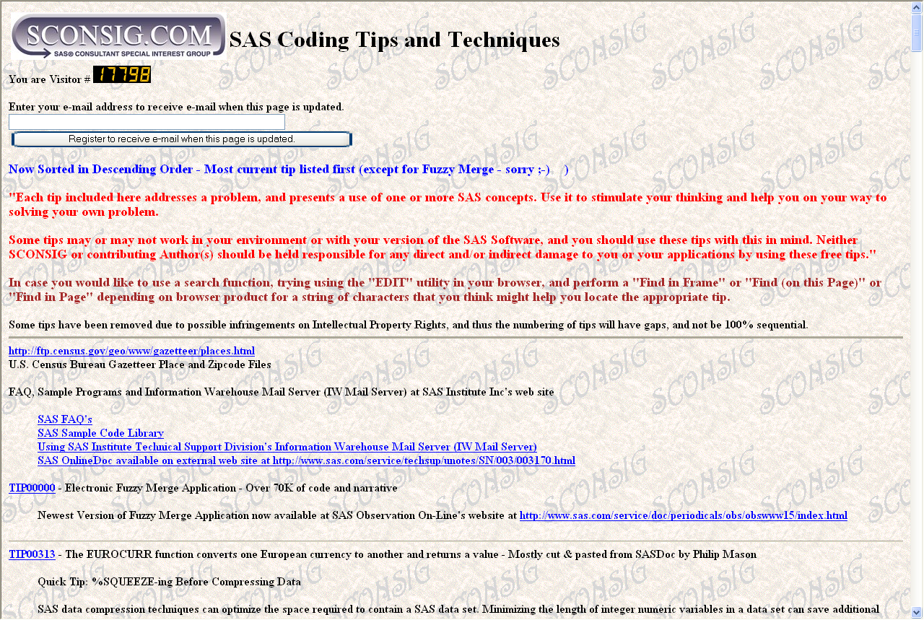
www.sconsig.com/sastip.htm

Slide 146
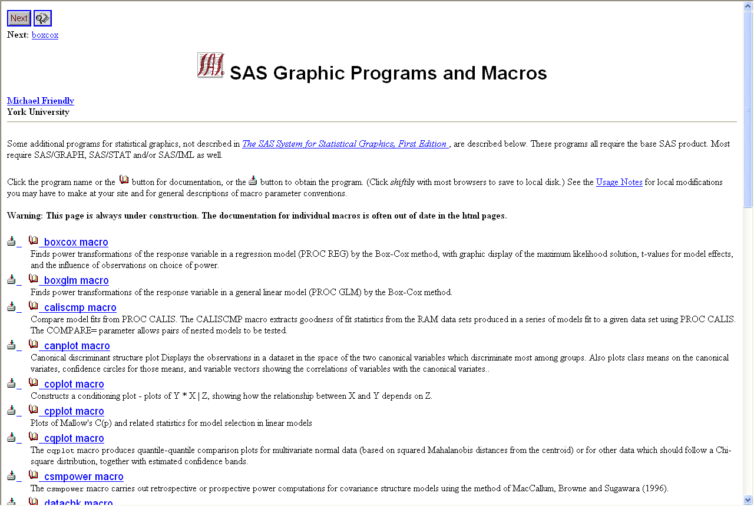
www.math.yorku.ca/SCS/sasmac/

Slide 147
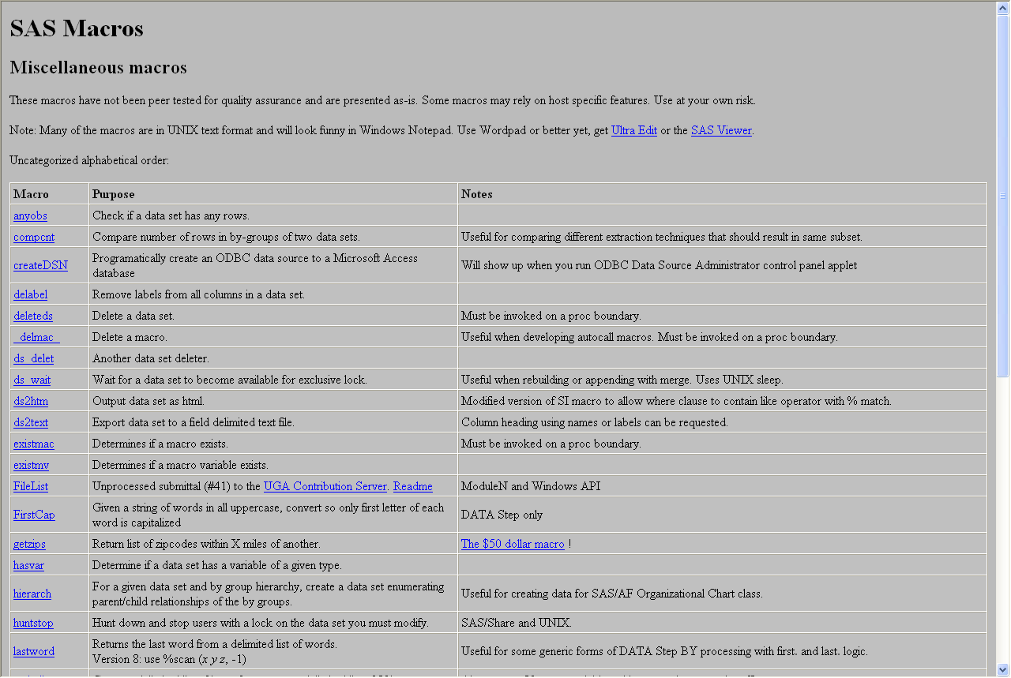
www.devenezia.com/downloads/sas/macros/index.html

Slide 148
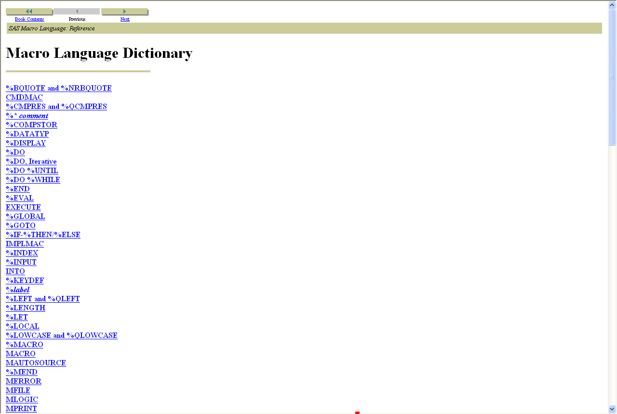
v8doc.sas.com/sashtml/macro/zenid-61.htm

Slide 149
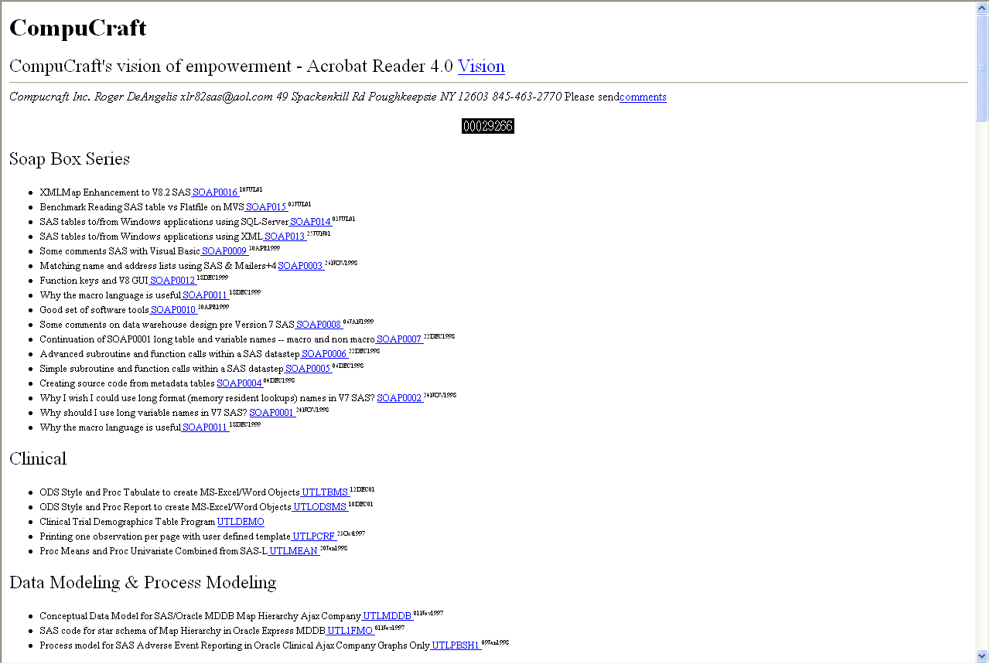
members.aol.com/xlr82sas/utl.html

Slide 150
Other References
Book Reviews
  “SAS Macro Language: Reference, First Edition”
  “SAS Macro Language: Reference, Version 8”
  “Debugging SAS Programs: A handbook of tools & techniques”
  “Carpenter's Complete Guide to the SAS Macro Language”
  “SAS Macro Programming Made Easy”

Slide 151
Any questions?

